Slide 1
Sequence diagrams Trial 4
Based on TIM 13-16/11/2018

Slide 2
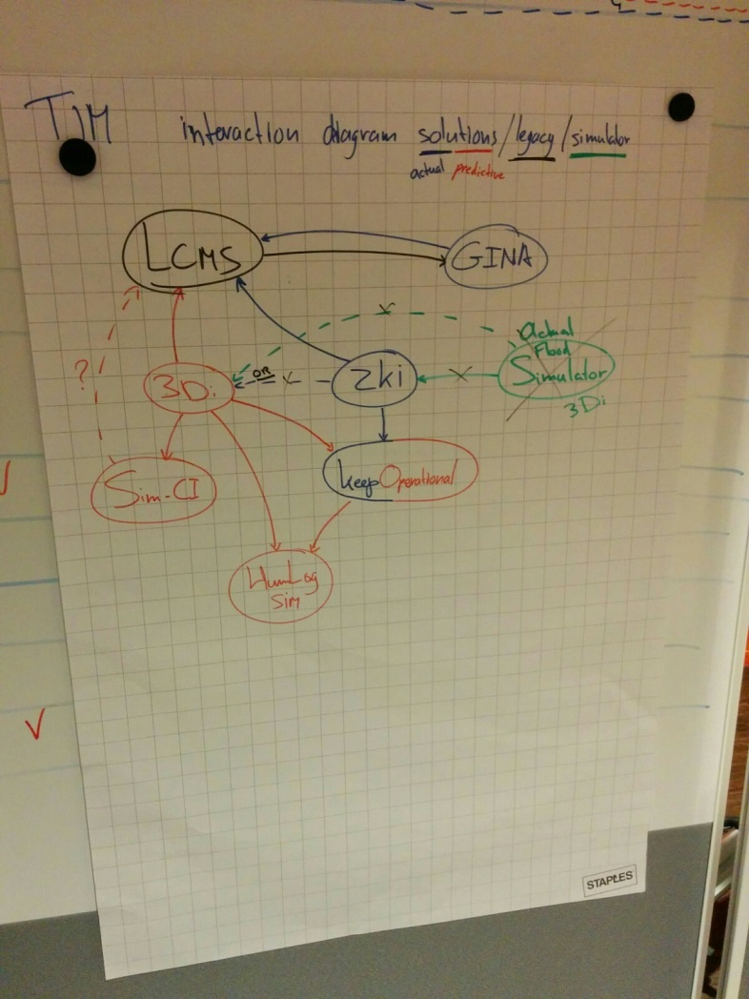
Interaction diagram

Slide 3
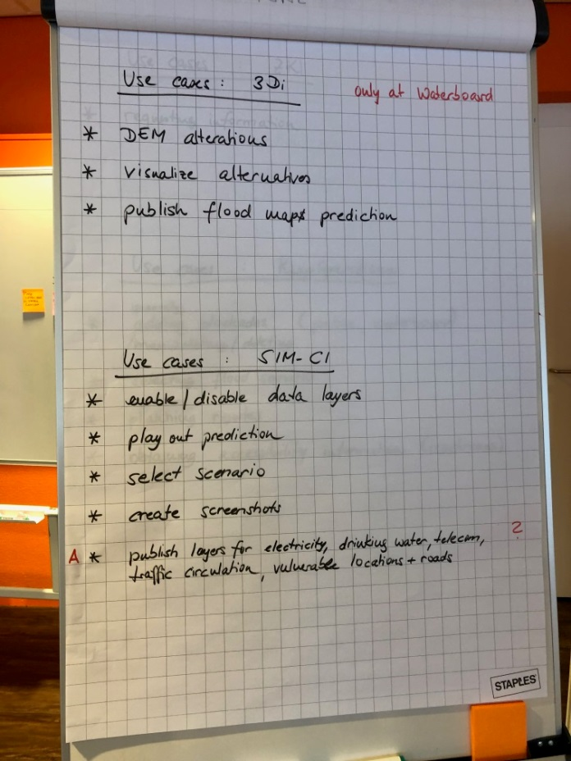
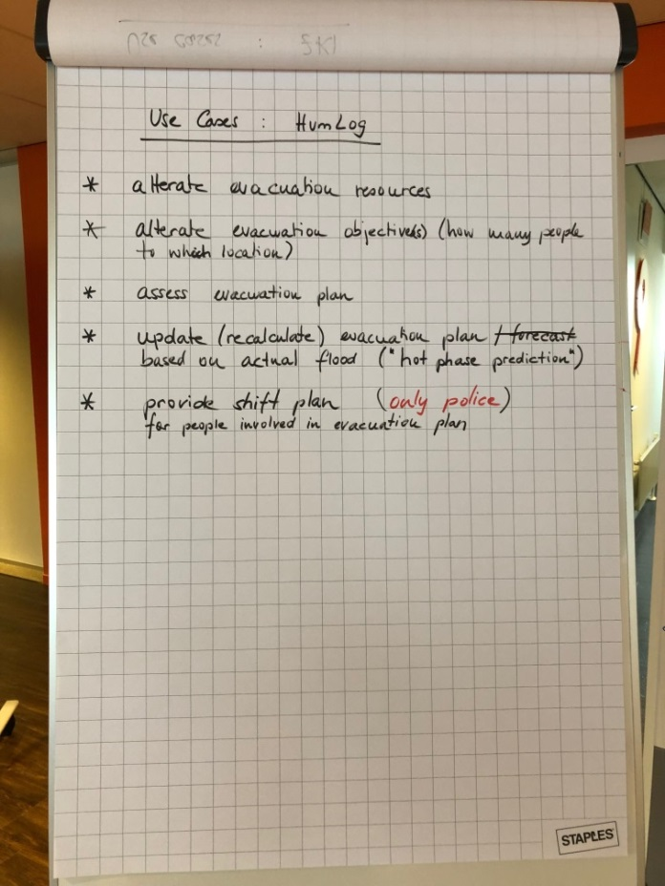
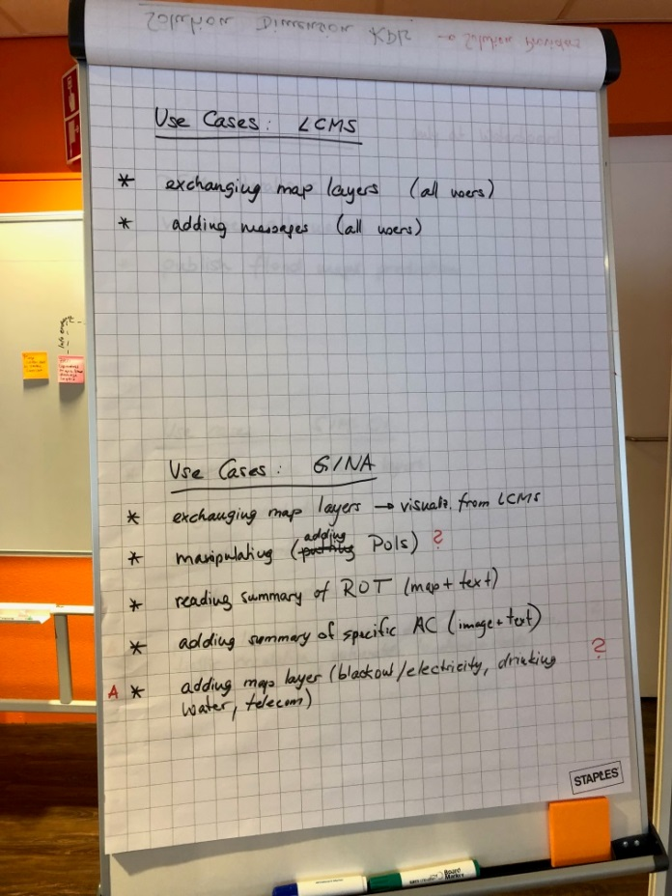
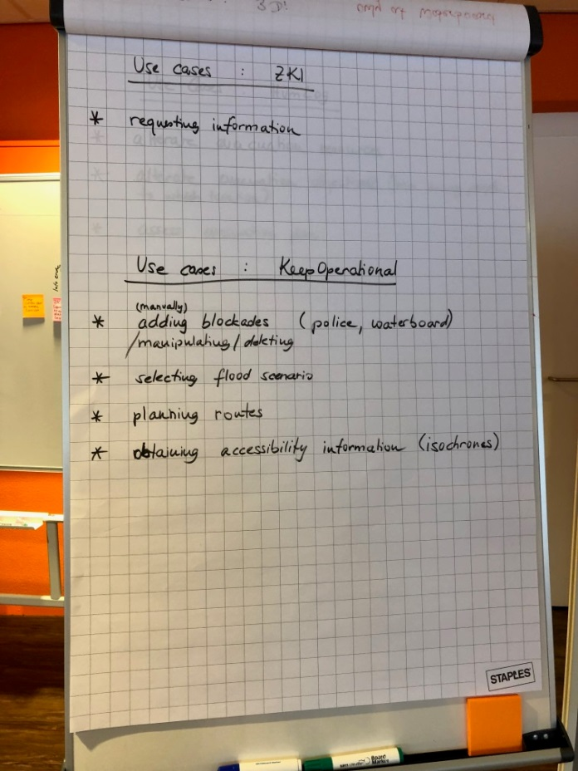
Use cases

Slide 4
3Di – Solution internal use cases
Digital Elevation Map (DEM) alterations
Visualize alternatives

Slide 5
3Di – Publish flood map prediction
LCMS
KeepO
HumLog
3Di
test-bed
converter
SIM-CI
CrisisSuite
Press <publish>
Store on server
(NetCDF & GeoTIFF)
Send system_large_data_update
(NetCDF)
Receive system_large_data_update (NetCDF)
Download NetCDF
Send system_large_data_update
(GeoTIFF)
Receive system_large_data_update (GeoTIFF)
Download GeoTIFF
Convert GeoTIFF
to GeoJSON
Send standard_geojson
Receive standard_geojson

Slide 6
SIM-CI – Solution internal use cases
Enable/disable data layers
Play out prediction
Select scenario
Create screenshots

Slide 7
SIM-CI – Publish layer (electricity, drinking water, telecom, traffic congestion, vulnerable buildings)
SIM-CI
test-bed
LCMS
Press <publish>
CrisisSuite
Generate GeoJSON
Send standard_geojson
Receive standard_geojson

Slide 8
HumLog Sim – Solution internal use cases
Alter evacuation objectives
Provide shift plan (only police AC)

Slide 9
HumLog Sim – Assess/Update evacuation plan
HumLog
KeepO
Press <assess>
Calculate
Request routing information
Calculate
Request routing information
Calculate
Request routing information
Calculate
Request routing information
.
.
.

Slide 10
LCMS – Legacy tool internal use cases
Display map layers
Adding messages

Slide 11
LCMS – Publish map layers
LCMS
converter
test-bed
CrisisSuite
Press <publish>
Send <map layer update>
Generate GeoJSON
Send standard_geojson
Receive standard_geojson

Slide 12
LCMS – Publish summary/overview
LCMS
converter
test-bed
CrisisSuite
Press <publish>
Get logs
Check for updates
Generate CAP
Send standard_cap
Receive standard_cap
Get logs
Check for updates
Get logs
Check for updates

Slide 13
CrisisSuite – internal use cases
Display map layers
Adding/editing summary/overview text

Slide 14
CrisisSuite – Publish map layers
CrisisSuite
test-bed
WMS server
LCMS
Press <publish>
Send standard_geojson
Receive standard_geojson
Generate WMS overlay
Send WMS overlay

Slide 15
CrisisSuite – Publish summary/overview
CrisisSuite
test-bed
converter
LCMS
Press <publish>
Send standard_cap
Receive standard_cap
Generate update
Apply update

Slide 16
ZKI – Solution internal use cases
Requesting damage assessment

Slide 17
ZKI – Requesting current flood map
LCMS
KeepO
ZKI
test-bed
CrisisSuite
Request info
Generate GeoJSON
Send standard_geojson
Receive standard_geojson

Slide 18
KeepOperational – Solution internal use cases
Adding/Manipulating/Deleting Blockades (only police AC)
Selecting flood scenario
Planning routes
Obtaining accessibility information (isochrones)

